Slide 1
What is the quality of your relationship with God? Ever wonder “is this all there is?”
Do You Love Me? is a brief, 4-week study that will change the way you look at what it means to be in a relationship with God, to do your life WITH Him, not FOR Him…or on your own.
Jesus offers us so much more than the life we’re actually living.
Discover how! Sign up today.
“Are you kidding me?
All it took was 4 weeks for “Do You Love Me?” to completely shift my perspective on the most important thing in my life: my relationship with God.”
Sean
WHERE/WHEN/HOW TO SIGN UP
WHO TO TALK TO
WHO TO TEXT
WEBSITE LINK

Slide 2
Do You Love Me?
What is the quality of your relationship with God? Ever wonder “is this all there is?”
Do You Love Me? is a brief, 4-week study that will change the way you look at what it means to be in a relationship with God, to do your life WITH Him, not FOR Him…or on your own.
Jesus offers us so much more than the life we’re actually living.
Discover how! Sign up today.
“Are you kidding me?
All it took was 4 weeks for “Do You Love Me?” to completely shift my perspective on the most important thing in my life: my relationship with God.”
Sean
WHERE/WHEN/HOW TO SIGN UP
WHO TO TALK TO
WHO TO TEXT
WEBSITE LINK

Slide 3
For where two or three are gathered in my name, there am I among them. (Mt 18:20)”
Have you ever considered how Christ’s presence in our midst might influence the way you lead meetings, or your team?
The Art of Spiritual Leadership is a leadership training opportunity for anyone in our church—whether you lead a team or a small group here or at home!
“The format allowed me to see and learn from various styles of leadership. There were many moments when I thought: ‘Well, that’s a good idea!’” Pam
WHERE/WHEN/HOW TO SIGN UP
WHO TO TALK TO
WHO TO TEXT
WEBSITE INFO
“ASL helps leaders grow in relational skills, equipping them to cultivate greater attentiveness to the Spirit and fellow group members.” Brian

Slide 4
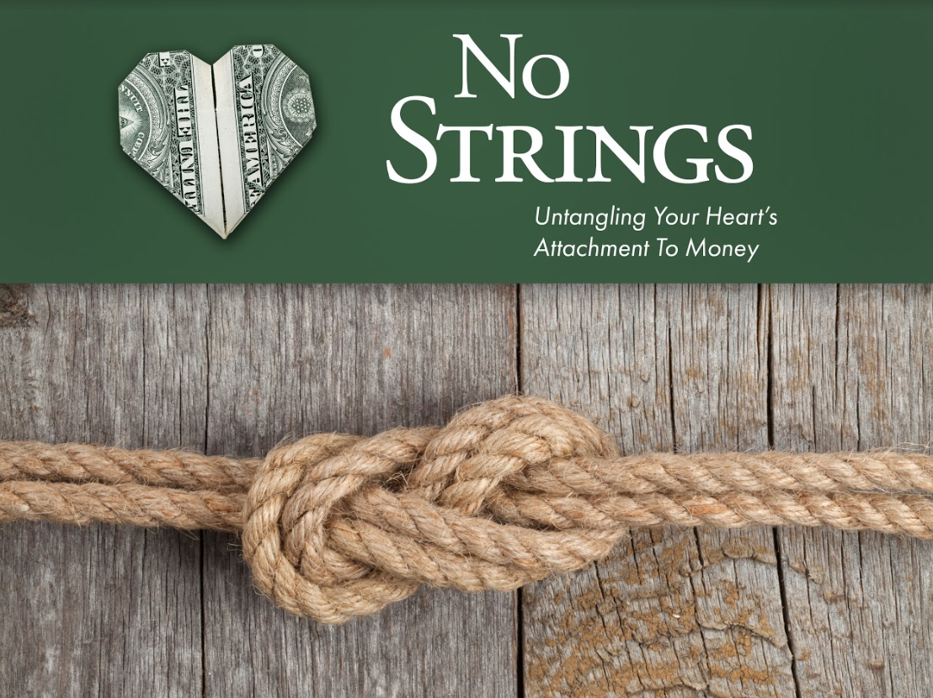
What does money mean to you?
We don’t talk about it much, but Jesus sure did!
No Strings is a small group study—not on the mechanics of budgeting and spending, but on discovering true freedom in life…no matter the size of your bank account.
Interested? Sign up today!
Security!
Contentment!
Ugh! Arghh!
WHERE/WHEN/HOW TO SIGN UP
WHO TO TALK TO
WHO TO TEXT
WEBSITE LINK

Slide 5
What does money mean to you?
We don’t talk about it much, but Jesus sure did!
No Strings is a small group study—not on the mechanics of budgeting and spending, but on discovering true freedom in life…no matter the size of your bank account.
Interested? Sign up today!
WHERE/WHEN/HOW TO SIGN UP
WHO TO TALK TO
WHO TO TEXT
WEBSITE LINK

Slide 6
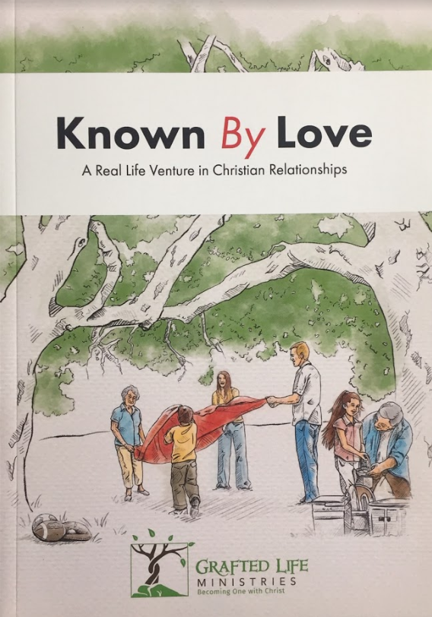
Are you looking for deeper and more enduring friendships in our church community?
Known By Love is an interactive experience designed to break down the Biblical concept of love into practical skills that support and nourish your relationships with family, friends…and God.
Groups are forming now!
WHERE/WHEN/HOW TO SIGN UP
WHO TO TALK TO
WHO TO TEXT
WEBSITE INFO
"Known by Love gave us a practical 'how to' for responding to God's invitation to go deeper. It facilitated a moment-by-moment relating to God and experiencing His abundance, instead of just talking about it.“ Amber

Slide 7
Life with God
Are you longing for authentic community? Tired of doing life on your own?
Jesus offers us so much more than the life we’re actually living.
Life with God: The Genesis of Relationship is a small group experience where you can discover how to do life WITH God and in meaningful community with others.
Sign up today. Space is limited!!
WHERE/WHEN/HOW TO SIGN UP
WHO TO TALK TO
WHO TO TEXT
WEBSITE LINK

